Slide 1


Hotel Aggregator Analysis
Shubham Chandarana

Slide 2
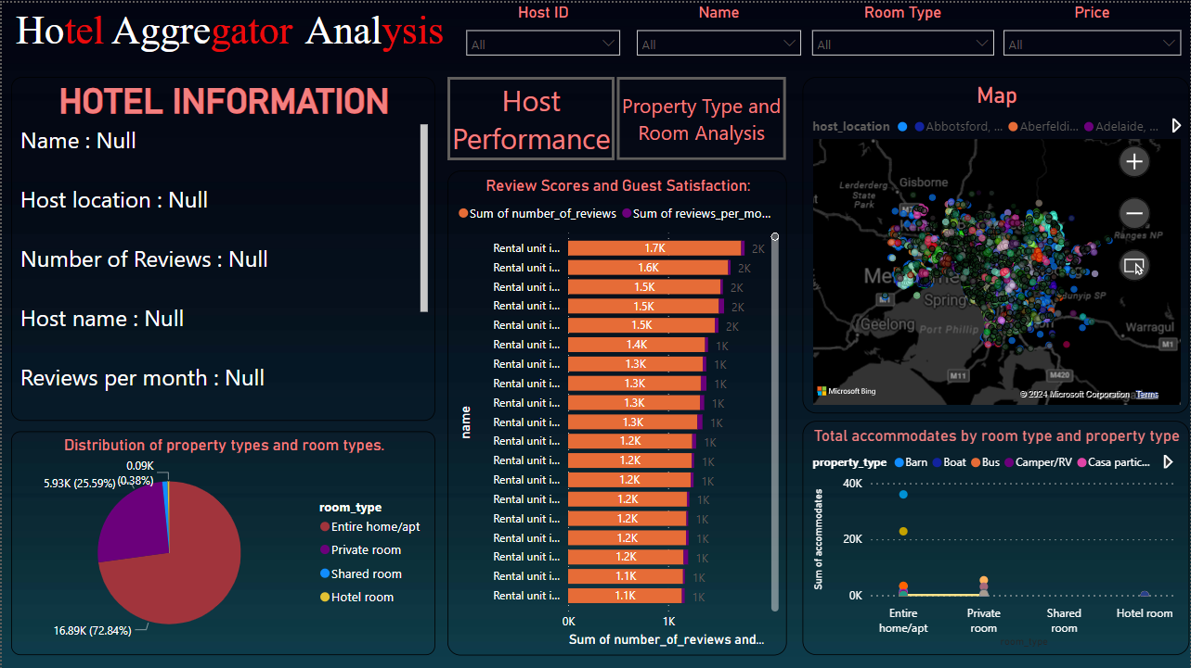

Slide 3
Hotel Aggregator Analysis
We have taken four Slicer to filter data Host id , Name , Roomtype , Price .
we are also using map in which we can see Neighbourhood and Listing of names for particular location using latitude and longitude.
we are using text value property for getting dynamic value from database as an hotel information.
We have also insert 2 button host performance and property type and room type Analysis which re-direct to another page.
We have also taken stacked bar chart In which we are showing name of listing and total reviews and reviews per month.
We are also using line chart in that we are adding total accommodates by room type and property type.
And in last we add Pie chart in that we are showing room type and count of property type.

Slide 4
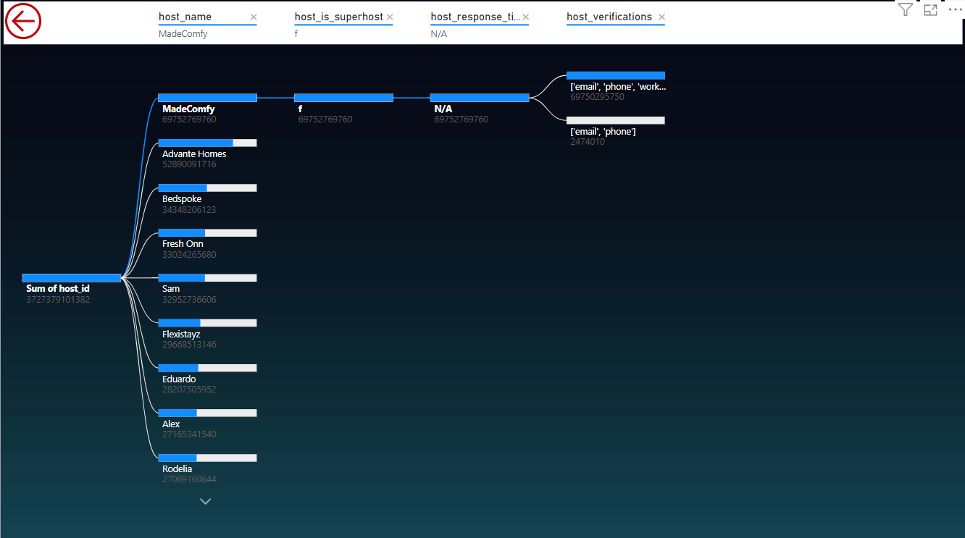
Host performance
In this page we are using Decomposition tree in that we are showing host information like host name , superhost , host response and host verfications.and also using back button.

Slide 5
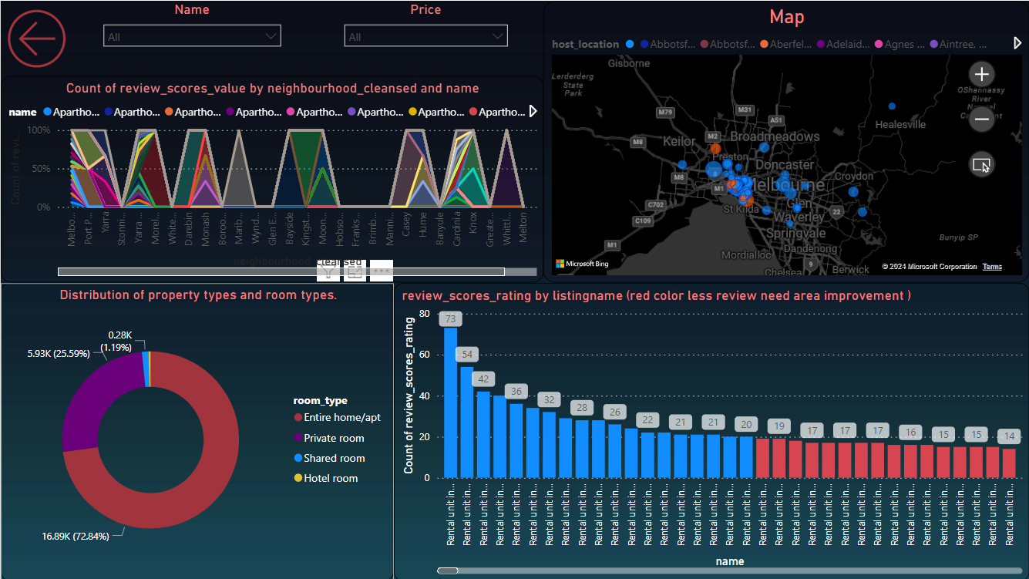
Propert and room type Analysis

Slide 6
Thank you
HOTEL

